Slide 1
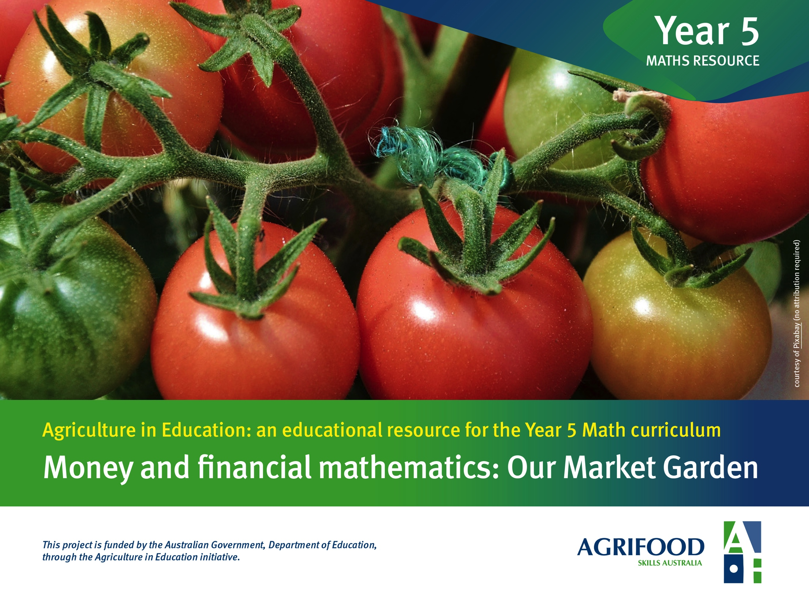

Slide 2

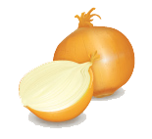
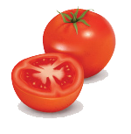
Work Task 1: Planning our Market Garden
Our Market Garden > Work Task 1
To research and design a garden bed, including its location and the layout of chosen crops. The garden bed is to be used for a small market garden that our class could manage. We want our garden to be sustainable so you must allow for maintenance and crop rotation.
Below are some questions to help you in your research :
In order to sustain our garden we should practice crop rotation. What does this mean and how does it affect the crops we choose?
What do crops need to help them grow?
Where could a garden patch be established in our school?
What size will our garden be?
What sort of crops would be most suitable for us to grow?
When should we plant our seeds?
How long does it take these crops to grow from seed to be ready for harvest?
What yield can we expect from these crops?
Do we plant seeds or seedlings?
Where can you buy the seeds?
Is there anything else we could do to make our crops grow faster or be healthier?
Draw you garden plan on the worksheet 2 provided. Think carefully about sun, shade, access to water and how we will be able to look after it and harvest the crops.
Design and Make a Financial Plan for a Market Garden
> Money and financial mathematics
This work is a derivative of images courtesy by Freepik.com

Slide 3

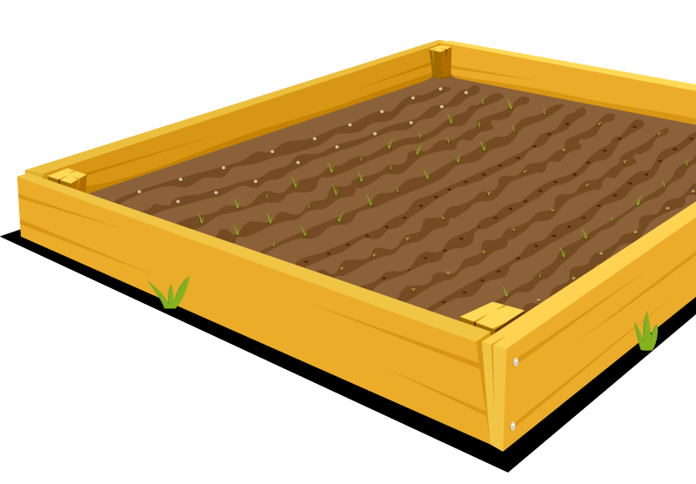
Planning our Market Garden > Worksheet 2: Garden Plan
Scale: 1 square =
_____________
Design and Make a Financial Plan for a Market Garden
> Money and financial mathematics
This work is a derivative of images courtesy by Freepik.com

Slide 4
Work Task 2A: Budgeting
Planning our Market Garden > Work Task 2
Find out how much it will cost to establish a market garden in our school.
  Draw up a budget for creating and maintaining your market garden including planting out your first crops.
    A budget is a list of all the costs so that you can see at a glance how much in total your garden will cost. A budget is a great idea because you can easily see where you might make savings or can afford to buy more.
  Use the worksheet provided.
  Begin by making a list of the tools, seeds, fertilisers, soil, garden edging, etc. that you will need.
  Make a note of what quantities of each item you will need.
  Use hardware and nursery catalogues or research online to find out the costs of these items.
Design and Make a Financial Plan for a Market Garden
> Money and financial mathematics
This work is a derivative of images courtesy by Freepik.com

Slide 5
Planning our Market Garden > Worksheet 2A: Budgeting
Costs
Item | Quantity | Cost per item | Total $
Total cost to establish garden for the first season = _____________
Design and Make a Financial Plan for a Market Garden
> Money and financial mathematics
This work is a derivative of images courtesy by Freepik.com

Slide 6
Planning our Market Garden > Worksheet 2B: Budgeting
Production estimates
Crop | How many Plants | How many kilos / bunches / items per plant | How much in total
Design and Make a Financial Plan for a Market Garden
> Money and financial mathematics
This work is a derivative of images courtesy by Freepik.com

Slide 7
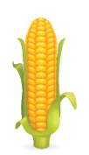
Work Task 2C
Planning our Market Garden > Work Task 2C: Budgeting
Due to lack of funds you have been told that your original budget has to be cut back. You must reduce your budget by $20.00!!!
You will still have the same size garden bed but somehow you must cut costs. Redo your budget and describe the decisions that you have made to make your garden still work.
Design and Make a Financial Plan for a Market Garden
> Money and financial mathematics
This work is a derivative of images courtesy by Freepik.com

Slide 8
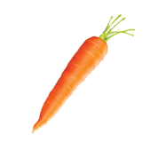
Work Task 3A: Budgets and Profits
Planning our Market Garden > Work Task 3
Calculate what your profit will be if you sell all your produce in the first season
To work this out you will first need to find out how much per bunch or per kilogram or per item you can sell your crops for. Supermarket catalogues (paper or online) will help you to find these.
Use the price per item to calculate the total amount you can expect for each of your crops.
Add all these totals together.
Finally, subtract the budget costs from this total.
0
0
Design and Make a Financial Plan for a Market Garden
> Money and financial mathematics
This work is a derivative of images courtesy by Freepik.com

Slide 9
Planning our Market Garden > Work Task 3A
Profit Calculator
Income
Product | Quantity | Selling Price per Unit | Total Value
Tomatoes | 25kg | $5 per kg | $125
$
Total sales for all crops = $________________
Costs – use the estimate from the Budget in Task 2A Total cost = _______________
Profit = Sales – Costs Your profit = _______ - ________ = __________
Design and Make a Financial Plan for a Market Garden
> Money and financial mathematics
This work is a derivative of images courtesy by Freepik.com

Slide 10


Work Task 3B: Budgets and Profits
Planning our Market Garden > Work Task 3B
Calculate how much profit you can expect to earn over a whole year. Do not include the setting up costs in these calculations, but you will need to work out a budget (costs) for the ongoing maintenance and buying new seeds, fertilisers and pest control, etc. if needed.
What could go wrong that might reduce your profit?
What will you do to try to prevent it?
What if there was a hail storm or pest damage?
Make a note of any adjustments for things that go wrong that you think should be taken into account in your calculations.
Design and Make a Financial Plan for a Market Garden
> Money and financial mathematics
This work is a derivative of images courtesy by Freepik.com

Slide 11
Planning our Market Garden > Work Task 3B
Work Task 3B: Year Profit
Income
Product | Average Price per Unit | Quantity | Estimated production | Adjustments
Costs
Design and Make a Financial Plan for a Market Garden
> Money and financial mathematics
This work is a derivative of images courtesy by Freepik.com

